Slide 1



C-007

Slide 2
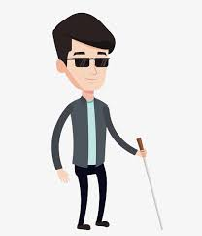
Tawaf guider
Tracking how many rounds the blind hajj did .
Using GPS starting from the Blackstone ‘the area between Blackstone and the green light’.
Inform the blind hajj when to say "Allah Akbar” to start next round until finishing the Tawaf.

Slide 3
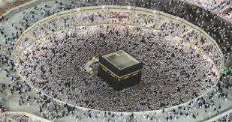
Team members
Nuof Al-Duailej ……………….………….5517
Fatima Bamashmoos..….………………3907
Sara Al-Sanaani……...…………………..3163
Amal Balubaid…………………………….3050
Shahad Almoajil…………………………..4424

